Slide 1


A Comparative Study of Consumer Preference:
Local Dairy Milk at Shyam Dairy
Business Data Management Capstone Project
Presented by: Manya Sharma Roll No: 21F3001723

Slide 2
Background of Shyam Dairy
01
Overview: Shyam Dairy is a small-scale B2C business located in Shahdara, East Delhi, with over 40 years of history.
02
Specialization: Fresh milk, sourced daily from Ghazipur dairy farms, and also sells packaged milk and general store items.
03
Unique Selling Point (USP): Quality-rich, unadulterated fresh milk.
04
Key Challenge: Competing with cheaper and more accessible packaged milk, affecting sales and customer retention.

Slide 3
Problem Statement
Difficulty in acquiring new customers due to lack of advertising and competition from cheaper alternatives.
01
02
Fresh milk priced at ₹77/L compared to ₹68/L for packaged milk showing price sensitivity and limited operational hours for fresh milk availability (morning and evening only).
03
Seasonal and pricing factors leading to customer churn and inconsistent demand.

Slide 4
Objectives
Analyze customer preferences and sales trends.
01
02
Provide actionable recommendations to increase sales and retain customers.

Slide 5
Methodology
Data Collection: Sales records for fresh and packaged milk (May & October).
Data Cleaning: Addressing missing values, duplicate entries, and inconsistencies using Excel and Python.
Descriptive Analysis: Identifying trends and key metrics like mean, median, and standard deviation.
Retention & Churn Analysis: Measuring customer loyalty and acquisition.

Slide 6
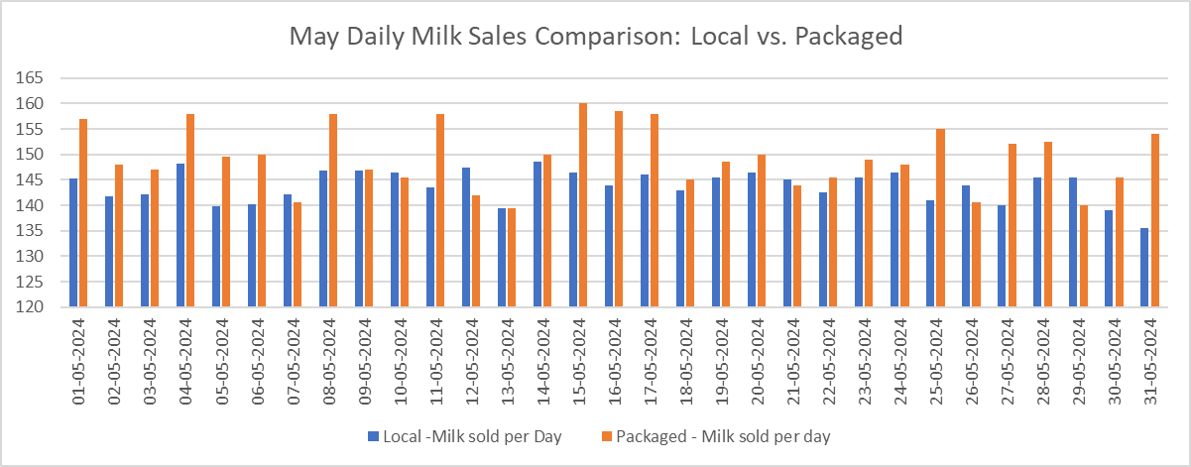
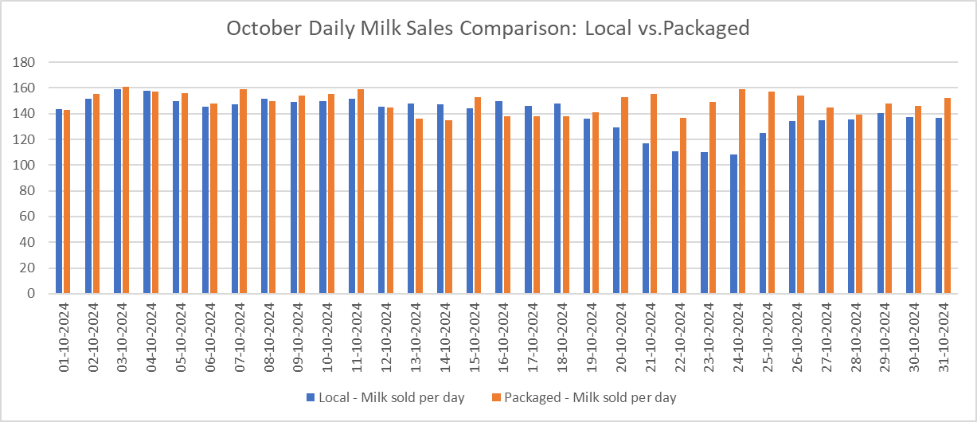
Results & Findings
Daily Sales Trends: Fresh vs. Packaged Milk
Key Observations
Fresh milk sales were stable in May but showed higher variability in October.
Packaged milk sales were more consistent across both months.

Slide 7
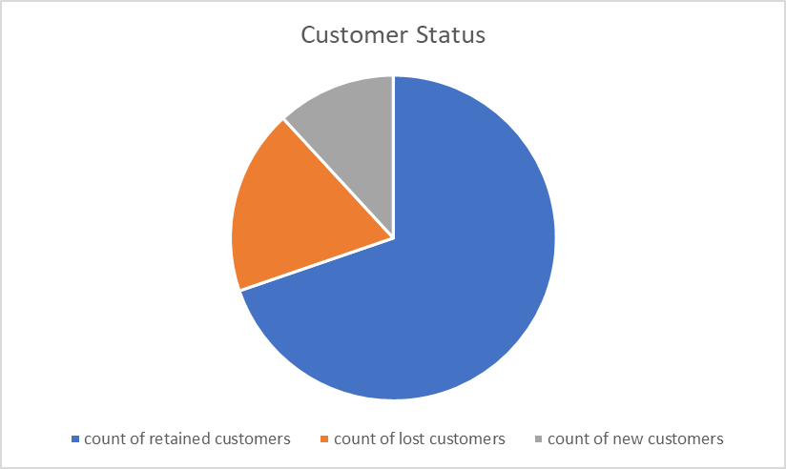
Results & Findings
Metrics:
•Retention Rate: 69.73%
Churn Rate: 18.42%
New Customers: 9
Customer Retention and Churn Analysis
Key Observations
High retention indicates customer loyalty.
Churn rate highlights sensitivity to price
and availability.

Slide 8
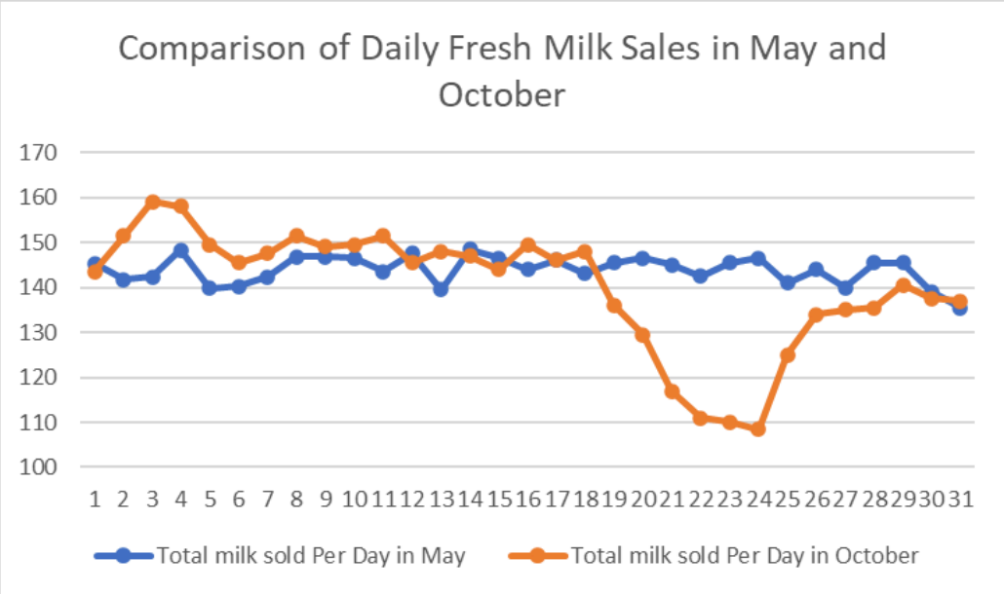
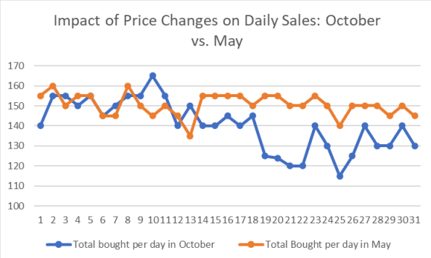
Results & Findings
Comparison of Local Milk Sales: May vs. October
Key Observations
May sales were stable with consistent demand, while October showed significant fluctuations.
October's sales dips highlight sensitivity to price changes and seasonal factors.
Lower average daily sales in October reflect a decline in demand compared to May.
Variability in October sales suggests a need for price stability and targeted promotions.

Slide 9
Key Insights
Trend | Insight
Daily Sales Trends | Fresh milk showed higher variability in October compared to May. Packaged milk remained stable.
Retention & Churn | Retention rate: 69.73% (strong loyalty), but churn rate: 18.42% indicates improvement is needed.
Customer Preferences | Packaged milk consistently outperformed fresh milk due to lower price and round-the-clock availability.
Fresh Milk Variability | Fresh milk sales were more sensitive to price and seasonal factors, highlighting unpredictability in October.

Slide 10
Recommendations
Offer discounts during low-demand periods.
Highlight health benefits of fresh milk through targeted marketing campaigns.
Introduce loyalty programs and personalized rewards for regular customers.
Address churn by collecting feedback and improving services.
Boost Fresh Milk Sales
Enhance Customer Retention
Counter Seasonal Decline
Expand Operational Reach
Seasonal campaigns emphasizing the benefits of fresh milk.
Stabilize pricing to attract price-sensitive customers.
Increase fresh milk availability hours or offer delivery services to improve customer convenience.

Slide 11
Conclusion
Summary of Findings: Fresh milk sales are sensitive to price changes, while packaged milk remains a customer favorite.
Recommended Actions: Loyalty programs, targeted promotions, and seasonal campaigns.
Impact: Improved sales, better customer retention, and enhanced market competitiveness for Shyam Dairy.

